Slide 1
Image Data Augmentation
Get started: edgeimp.com/evs23-data-augmentation

Slide 2
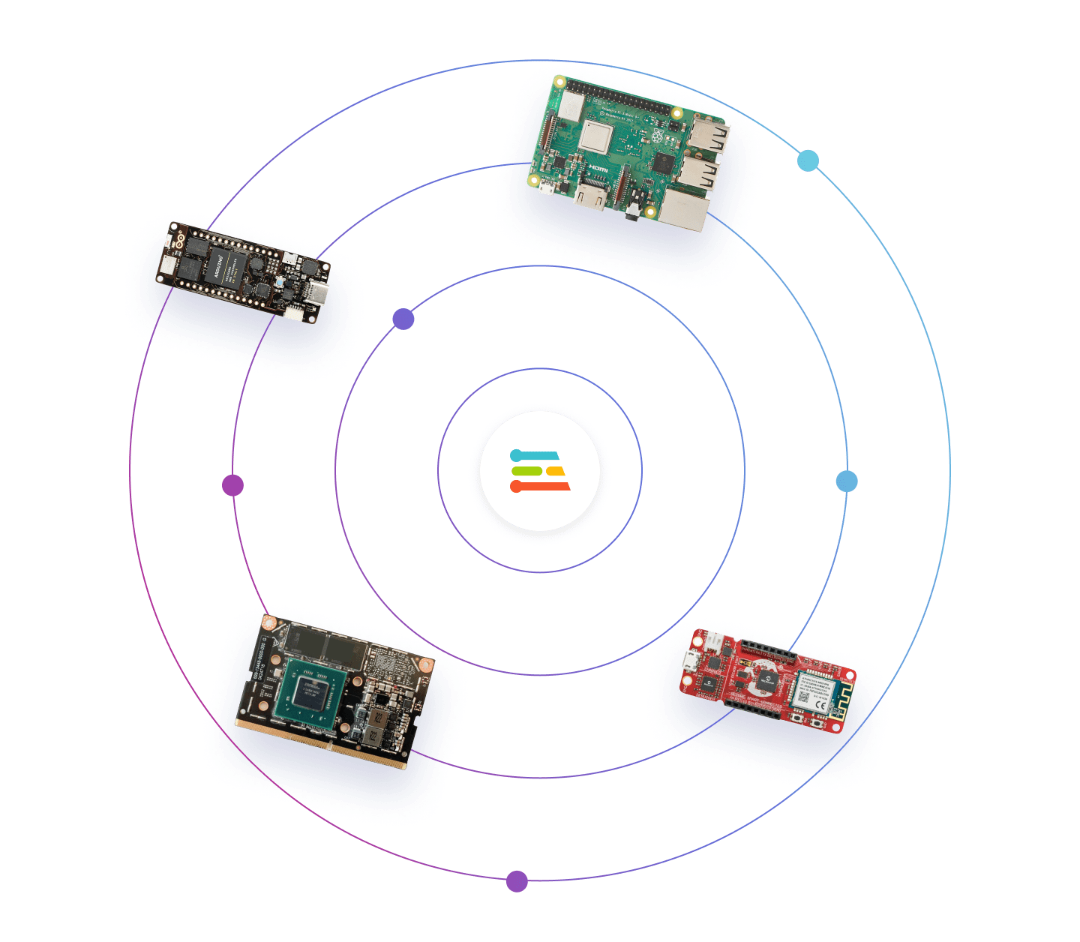
Agenda
Introduction
Why data augmentation
Hands-on workshop
Going further
Get started: edgeimp.com/evs23-data-augmentation

Slide 3
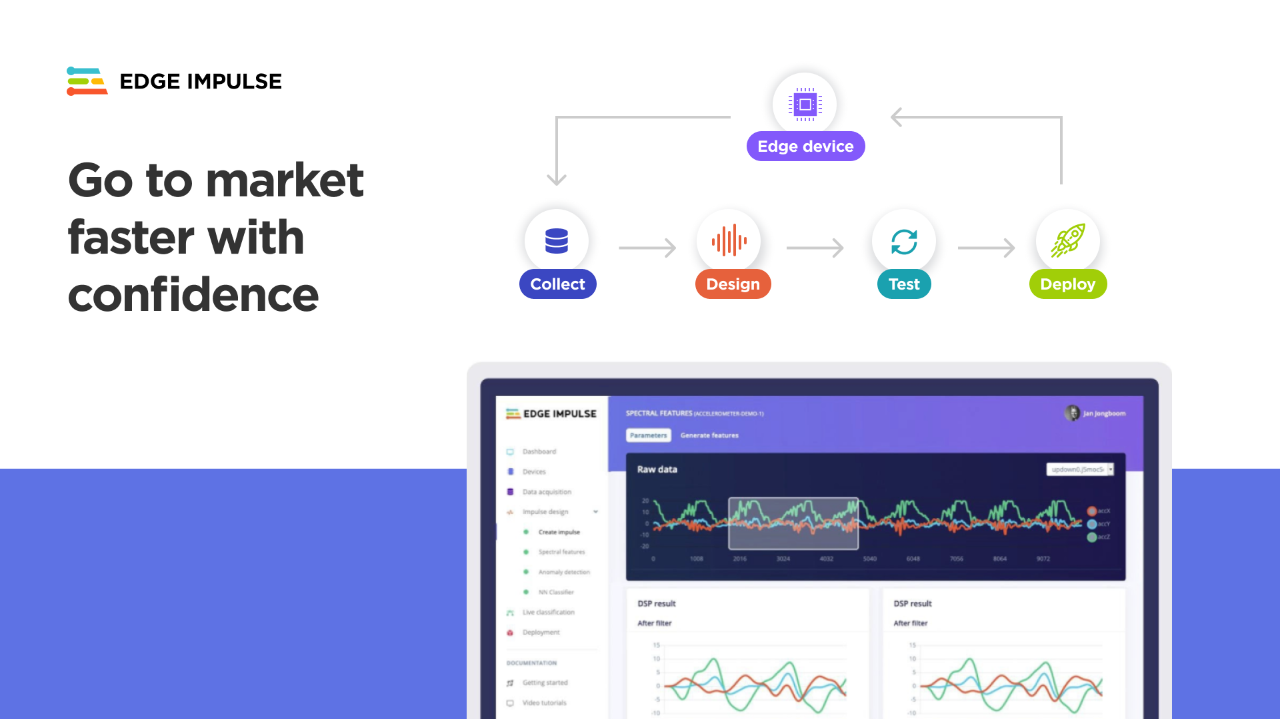
Notes:
Online platform
Collecting data - upload files or live from embedded device
Preprocessing feature extraction
Training model
Testing with saved and live data

Slide 4

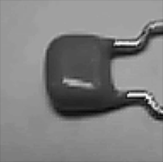
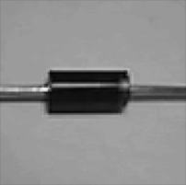
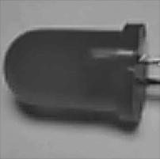
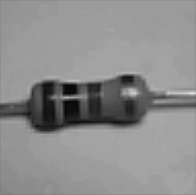
Image Classification
background
capacitor
diode
LED
resistor

Slide 5
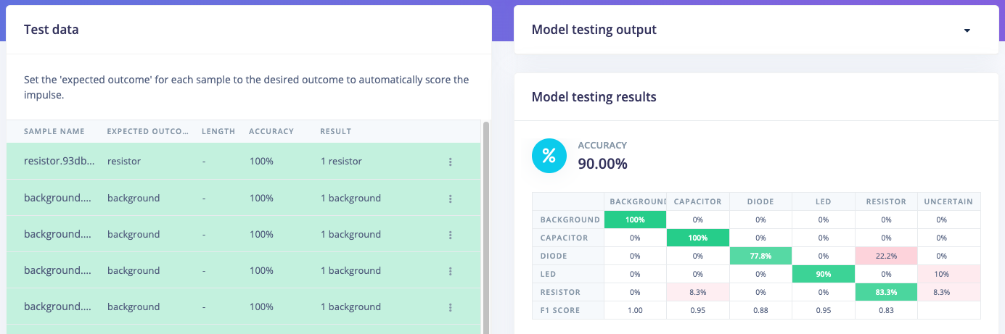
Hands-on: small dataset project
Get started: edgeimp.com/evs23-data-augmentation

Slide 6
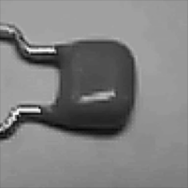
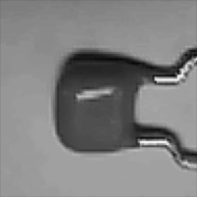
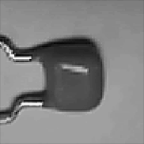

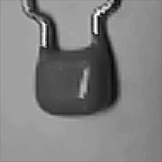

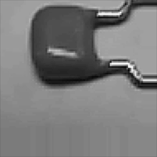



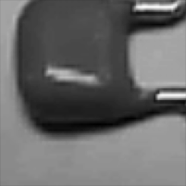

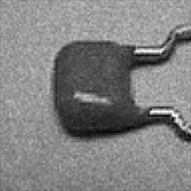
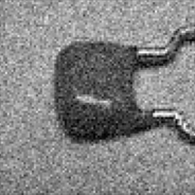
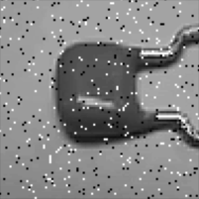
Data
Augmentation
flip
rotate
1 original image generates 15 augmented images
16 total images
250 original samples become 4000 samples
Not shown: compound transformations!
translate
original
zoom
noise

Slide 7
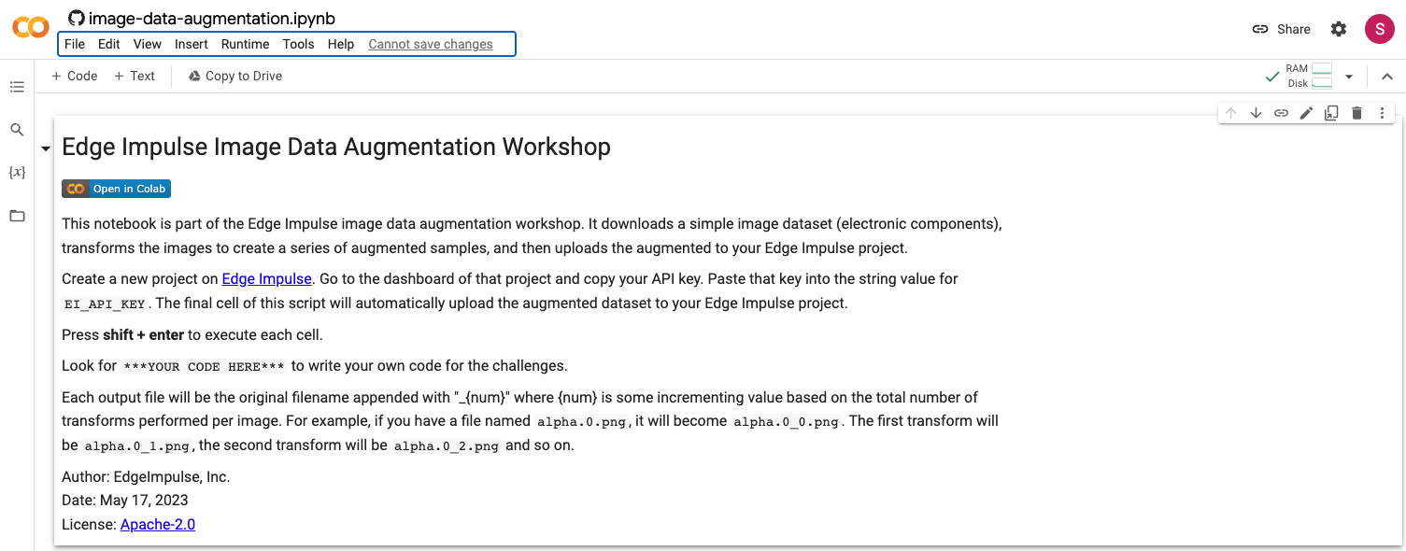
Hands-on: data augmentation
Get started: edgeimp.com/evs23-data-augmentation

Slide 8
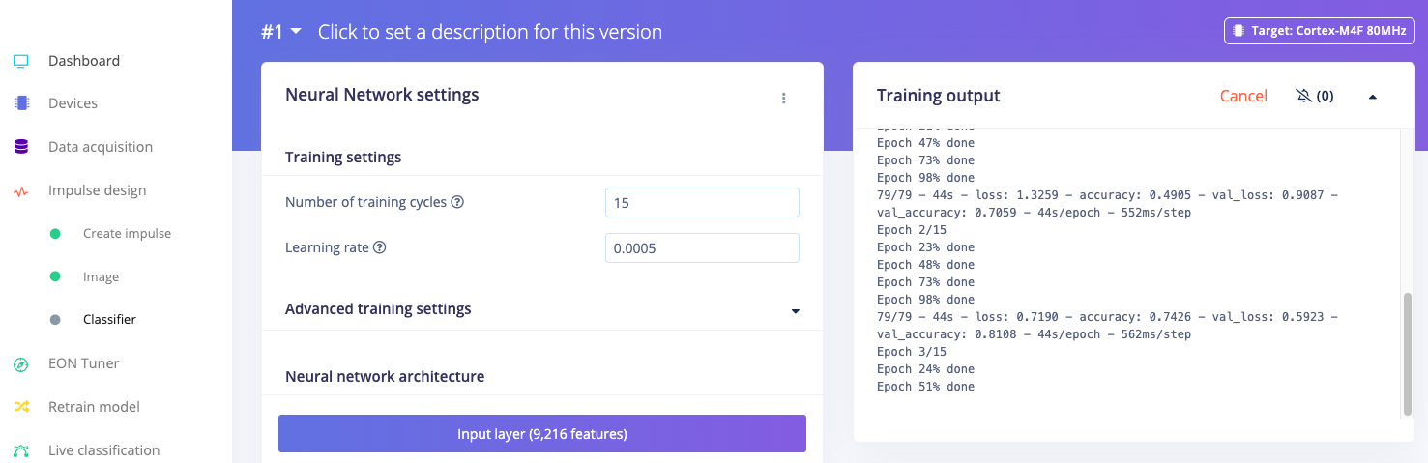
Hands-on: retraining the model
Get started: edgeimp.com/evs23-data-augmentation

Slide 9

Going Further
Time series data augmentation
Frequency drop, shift
Translation
Mix background noise
Synthetic data
Generate data (e.g. with AI)
Text-to-speech for keyword spotting

Slide 10
Automating Data Augmentation
ML frameworks
Augment/synthesize data as it is loaded during training
Easy to reproduce
Saves storage space
Difficult to analyze data
Per project
Augment/synthesize data to produce new dataset
Easy to reproduce
More storage space required
Easy to analyze data
Data store
S3 bucket, Edge Impulse organization
Transformation Block
Extract features, augmentation, synthesis
Project Data
Analyze, train ML model

Slide 11
Notes:
ROI Slide (Enterprise) - costly, 5 people, it will slow you down. Slow the ability to innovate and differentiate
Channel model - hardware target support or channel model

